Slide 1






Hi, JRC Murthy
Logout
Dashboard
Employee Attendance
Search Employee
Employee Add/Delete
Test Results
Report Generation
FAQ’s
About Us | Terms of Use | GMP Standards | Privacy Policy
Copyright 2019 Shantha Biotechnics Private Limited – All Rights Reserved

Slide 2
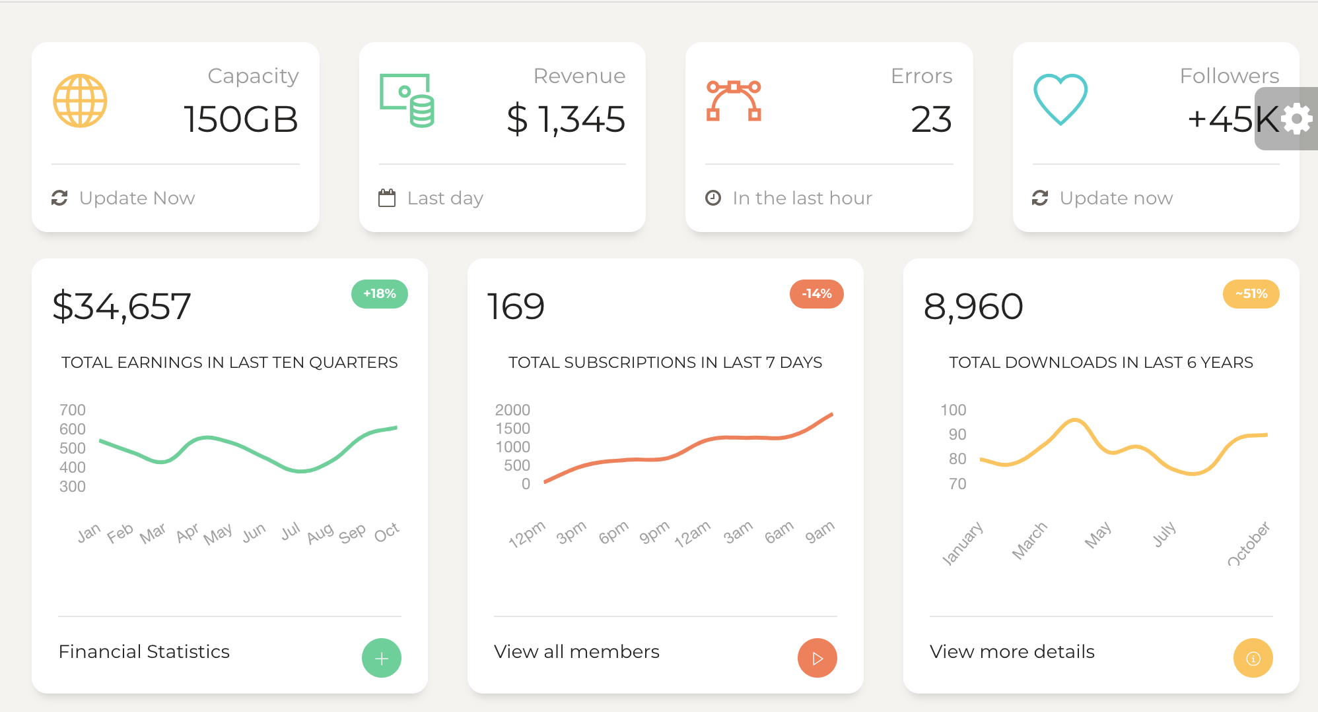
Hi, JRC Murthy
Logout
Generate New Batch
Dashboard
Employee Attendance
Search Employee
Employee Add/Delete
Test Results
Report Generation
FAQ’s
About Us | Terms of Use | GMP Standards | Privacy Policy
Copyright 2019 Shantha Biotechnics Private Limited – All Rights Reserved

Slide 3
Hi, JRC Murthy
Logout
Dashboard
Employee Management //shivay you can change the heading
Employee Attendance
E
Employee ID
Enter
Search Employee
Employee Add/Delete
Audit Table
Test Results
Batch Id | Type | Generated On | Generated By
BS-1232 | Occupation Certificate | 26-03-2018 | Kam Avida
Report Generation
FAQ’s
About Us | Terms of Use | GMP Standards | Privacy Policy
Copyright 2019 Shantha Biotechnics Private Limited – All Rights Reserved

